Slide 1
Analysis Report (student performance DATA) – Divyansh Dubey

Slide 2
Project Description
Context
Marks secured by the students
Content
This data set consists of the marks secured by the students in various subjects.
Acknowledgements
http://roycekimmons.com/tools/generated_data/exams
Inspiration
To understand the influence of the parents background, test preparation etc. on students performance

Slide 3
Design
Tools used for analysis, visualisation and reporting:
Ms excel
I used google-spreadsheets for analysing data as it is easy to use and a handy tool for data analysis.
Tableau
Tableau is one of the most popular visualisation tools across the world because of its easy to use and handy interface to work on.
Ms PowerPoint
I used MS PowerPoint for reporting because of its extensive features list which we can use to present reports. It is really easy to use.

Slide 4
Design
Steps:
Read and worked on understanding the data.
Consolidate the relevant data.
Data cleaning
Removed duplicates
Removed blank cells
Removed/replaced inconsistent data
Used the VLOOKUP function to find and organise this information on a separate sheet.

Slide 5
Design
Steps:
Data visualisation
Created the following Pivot Tables and Charts using excel and tableau:
Average Percentage by gender (Bar Chart)
Effect of parental education on the performance of the kids (Bar Chart)
Effect of lunch type on the performance of the kids(Bar Chart)
Effect of test preparation on the performance of the kids (Bar Chart)
Average Percentage among different ethnicities (Bar Chart)

Slide 6
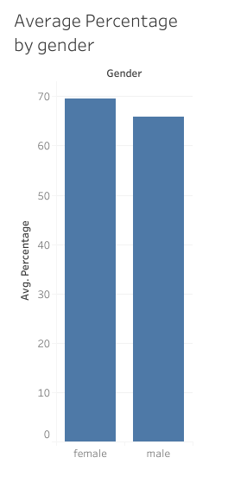
Findings and Insights
Female Students performed relatively better than Male Students.

Slide 7
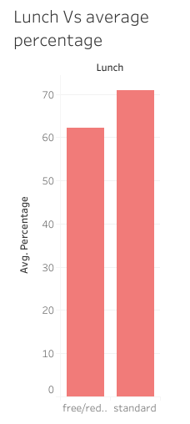
Findings and Insights
Students having standard lunch had performed relatively better than students with free/reduced price lunch.

Slide 8
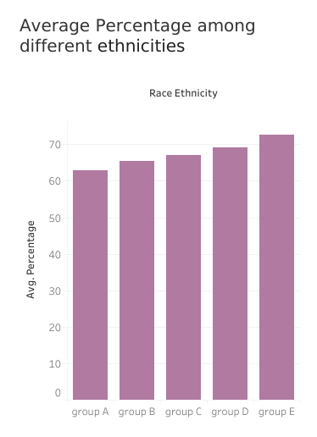
Findings and Insights
Students from different Ethnicity Groups performed differently.
Students from Group E performed better than students from other groups.
Students from Group A performed worse than students from other groups.
Performances of the students Group E was best, followed by Group D, C, B and then A.

Slide 9
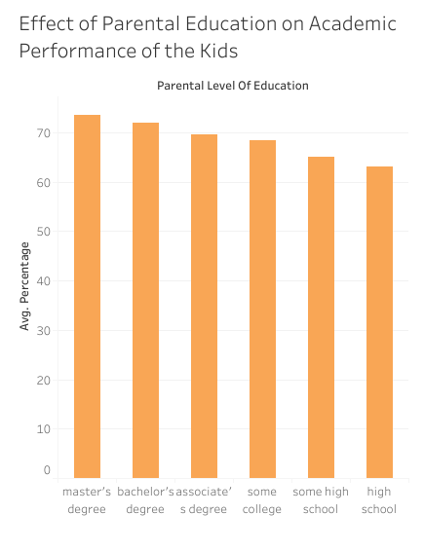
Findings and Insights
Education Level of the parent plays a significant role in the performance of the child as we can see in the graph on right.
As you can see in the graph, Kids of parents having Master’s degree performed best among all, followed by parents with bachelor’s degree, parents with associate’s degree, etc.

Slide 10
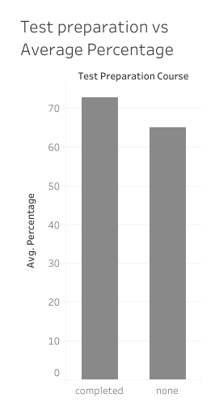
Findings and Insights
Students who completed their test preparation performed significantly better than the students who didn’t.

Slide 11
Analysis: Reasons/causes behind Insights
Female students have performed well in the exams as schools and government have employed female friendly policies, which aided significantly to their hard-work.
Food and Nutrients plays a significant part in the growth of the child, which also involves academic learning and thus what a child eats also plays an important part in its learning, which can be seen in the lunch v/s average percentage chart.
As seen in the Race/Ethnicity v/s average percentage graph, the ethnicity child belonged to also have a significant influence on its performance, which may be due to various factors like economic conditions of the communities, social backwardness of the community, etc.

Slide 12
Analysis: Reasons/causes behind Insights
As we can see in the parental education v/s average percentage graph, parental education plays a huge part in child’s education. Being educated helps/support as well as influence child’slearning.
Last graph i.e., Test Preparation v/s average percentage, shows that being prepared for test significantly improved the performance of the student in the exams.

Slide 13
Conclusion: My proposals for solutions
As with only little upliftment, females are already doing well than males. Government and institutions should keep running more and more encouraging policies for women.
Special care should be given to child’s nutrition. Every child’s nutrition should be a priority, so that every child should get all the nutrients it needs through nutritious diet.
Upliftment of the backward races should be the top priority for the government and the institutions to encourage them towards learning.
Parents should also educate themselves as it will significantly effect the performance of the child in positive way.
Extra focus should be given on kids to revise and review what they have been taught before.

